Slide 1


We are a student start-up company.
#JiniHack

Slide 2
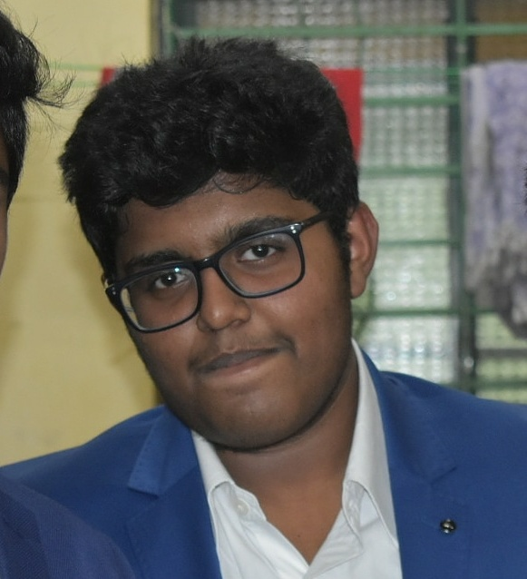
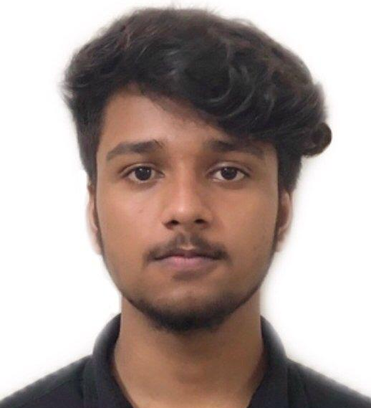

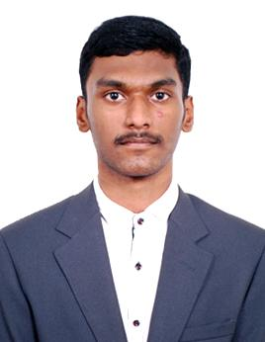


THE TEAM
FIRST YEAR ENGINEERING STUDENTS
BALASUBRAMNIYAM
SRI RAJA VIGNESH
VIKNESHWAR
SAMUEL WYCLIFFE
KUMARAGURU
PSG COLLEGE OF TECHNOLOGY
PSG COLLEGE OF TECHNOLOGY
PSG COLLEGE OF TECHNOLOGY
SRI KRISHNA COLLEGE OF ENGINEERING AND TECHNOLOGY
SRI KRISHNA COLLEGE OF ENGINEERING AND TECHNOLOGY
companyofbala@gmail.com
srirajarox@gmail.com
vikneshwaranandan@gmail.com
samuelwycliffe@gmail.com
kumaragurut7@gmail.com

Slide 3
EVALUATING OUR IDEA
01
Survey
Research
02
Business Model
03
We conducted a survey
to understand customer’s need.
We researched on the existing products and tried to be unique.
We designed a efficient business model.

Slide 4
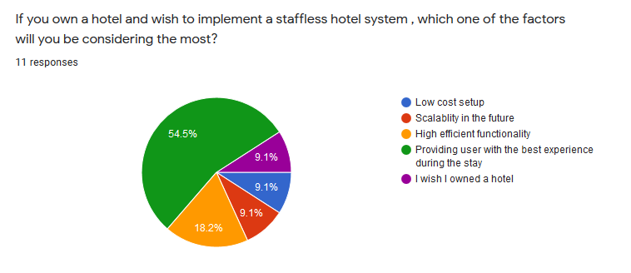
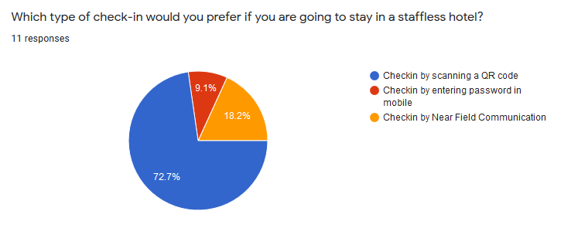
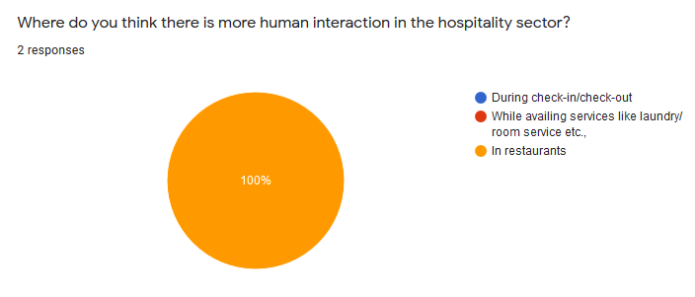
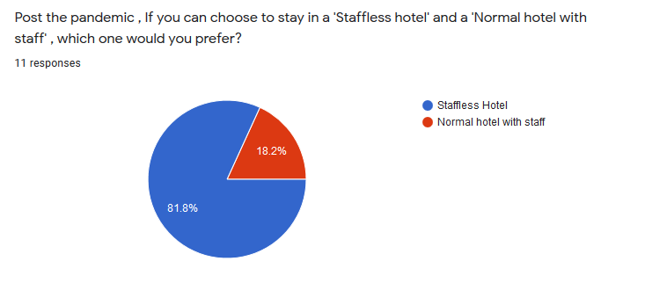
SURVEY RESPONSE

Slide 5
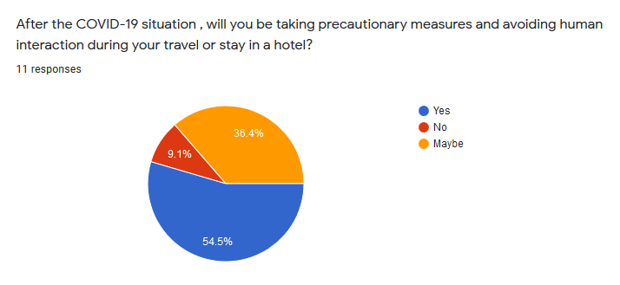
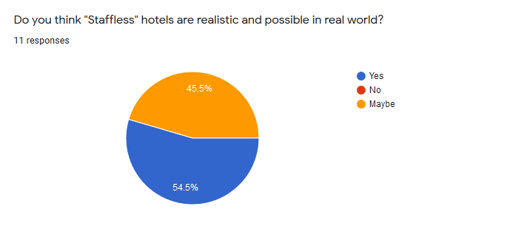
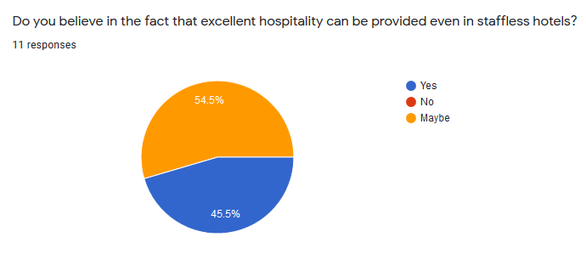
SURVEY RESPONSE

Slide 6
SURVEY INFERENCE
PEOPLE ARE CONCERNED ABOUT AVOIDING UNNECESSARY HUMAN INTERACTION EVEN AFTER COVID-19.
PEOPLE ARE MORE CONCERNED ABOUT COST OF SET-UP AND THE EFFICIENCY OF STAFFLESS HOTELS.
PEOPLE ARE MORE COMFORTABLE CHECKING IN BY SCANNING A QR CODE.
PEOPLE ARE COMFORTABLE REQUESTING SERVICES THROUGH THEIR MOBILE PHONE.
THE MARKET IS READY TO ACCEPT A STAFFLESS HOTEL AFTER THE COVID-19 SITUATION.

Slide 7
EXISTING PRODUCTS
THERE ARE ALREADY PRE-EXISTING
STAFFLESS HOTELS IN EUROPE , NORTH AMERICA , AUSTRALIA AND JAPAN.
THE EXISTING TECHNOLOGIES USED ABROAD CANNOT BE EASILY DEPLOYED IN SMALL AND MEDIUM SCALE HOTELS IN INDIA BECAUSE OF HIGH SET-UP COSTS AND INFRASTRUCTURAL NEEDS

Slide 8
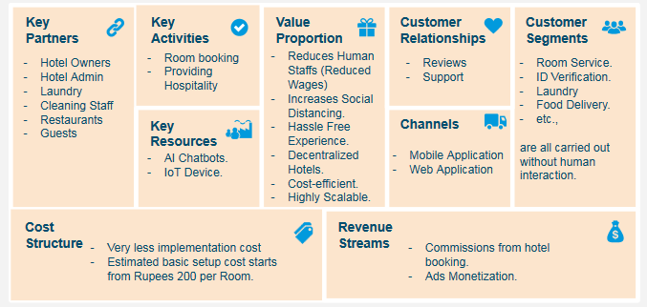
BUSINESS MODEL

Slide 9
IN A NUTSHELL
01
02
03
Book Hotels
Get Things Done
With App
Billing
We have a hotel booking platform where hotels can be listed.
Check-in , Availing services , billing and everything you need on your fingertips.
Keeping a record of the availed services and generating a digital bill.

Slide 10

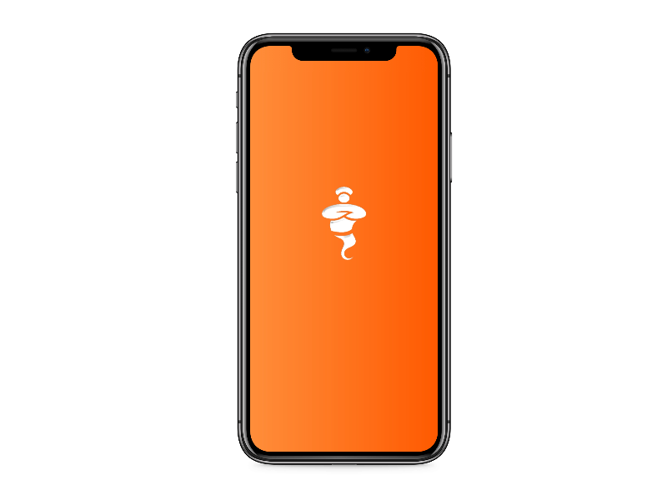
PLATFORMS
Mobile Application
Web Application
Developed for both users and hotels.
Developed only for hotels.
(We will be developing a webapp for users soon)

Slide 11
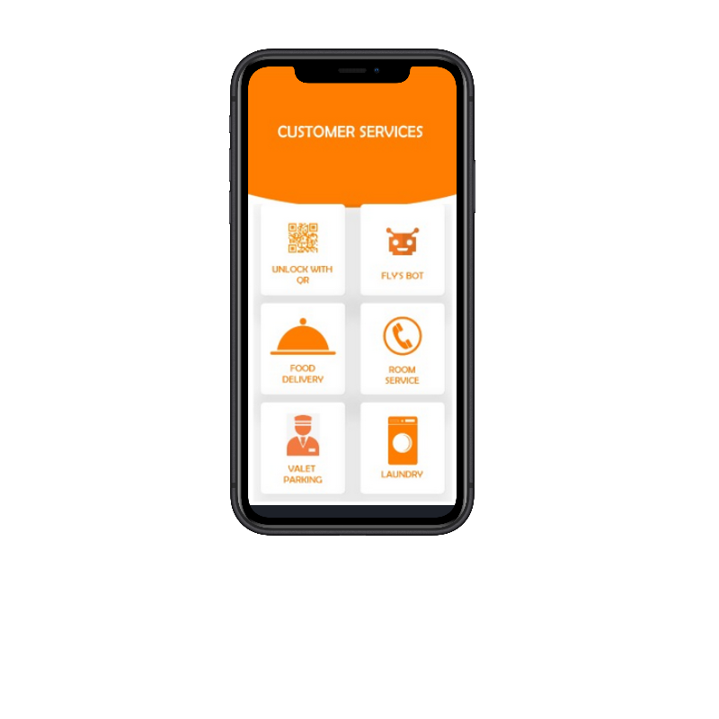




Mobile Application
Developed With
Fully functional application.
Implemented with Real-time database.
Secured with Google’s Firebase Auth System.
AI Powered Intelligent Chatbot.
Simple and Seamless UI/UX.
Personalized Alerts And Notifications.
Deployable condition.

Slide 12
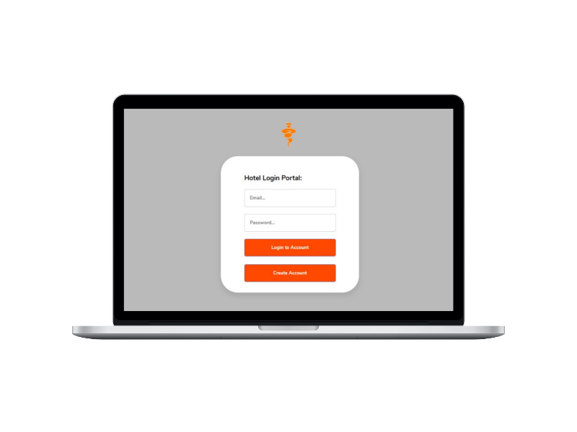




Web Application
Developed With
Developed only for Hotel management portal due to time constraints.
Secured real-time Firebase databases.
Secured Auth with Firebase.
Responsive and simple UI.
Detailed statistics of customers and guest history.

Slide 13
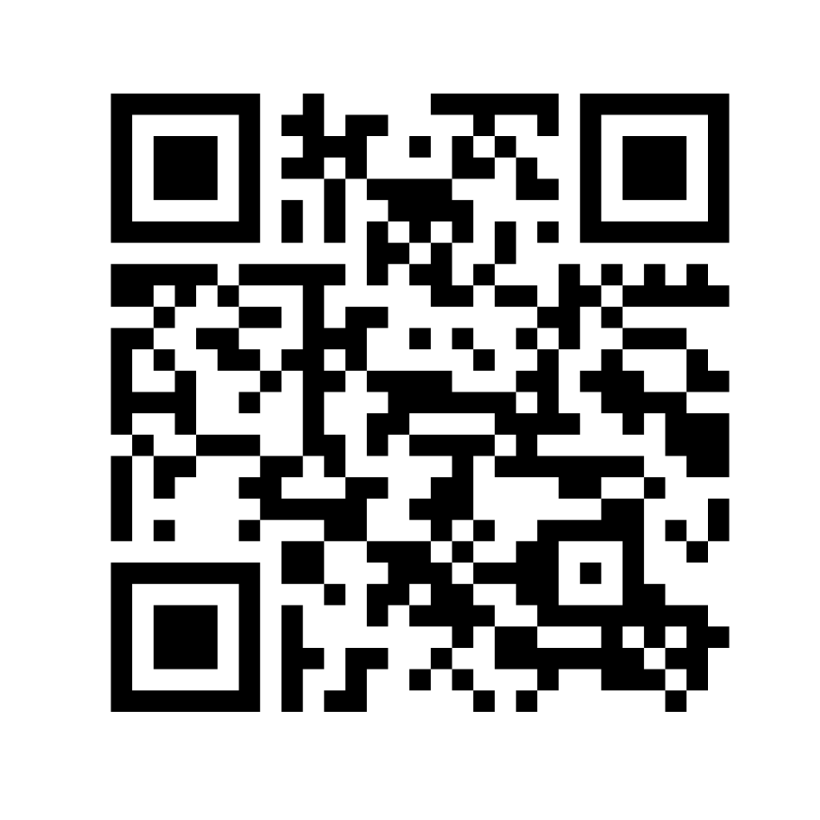







KEY FEATURES
CHECK-IN WITH
QR CODE.
ROOM SERVICE.
TRAVEL GUIDE.
AI POWERED CHATBOT.
LAUNDRY IN A TAP.
PERSONALIZED
ALERTS.
SAFE FOOD
DELIVERY.
VALET IN A TAP.
And more...

Slide 14



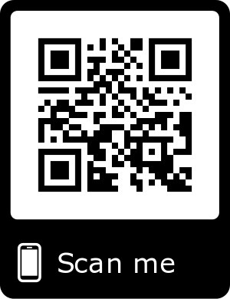
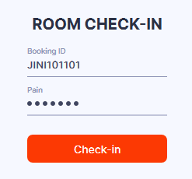
IoT - QR BASED DOOR SYSTEM
ROOM CHECKED IN AND
DOOR OPENS
USER MAKES BOOKING
THROUGH APPLICATION
UNIQUE CHECK-IN PIN GETS GENERATED FOR THE USER
CHECK-IN PIN IS STORED IN USER’S CHILD BRANCH IN FIREBASE.
UNIQUE QR CODE
PLACED ON ROOM DOOR
CHECK-IN LOGIN PAGE IS GENERATED
CHECK-IN UNSUCCESSFUL
DOOR DOES NOT OPEN

Slide 15
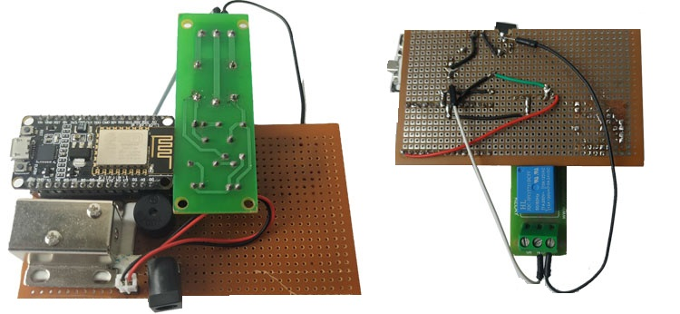
IoT - QR BASED DOOR SYSTEM
ESTIMATED COST OF SETUP
₹ 300
/room
EASILY AVAILABLE COMPONENTS
CHEAP COST-STRUCTURE
DEPLOYABLE PROOF OF CONCEPT
LOW MAINTENANCE COSTS
SCALABLE IN FUTURE

Slide 16
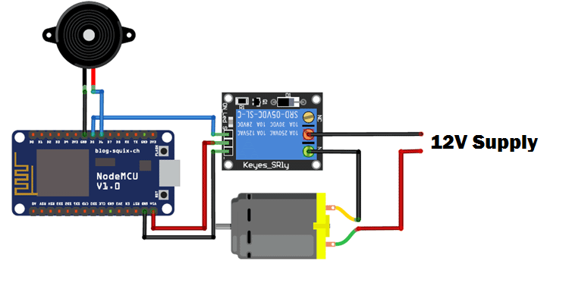
IoT - QR BASED DOOR SYSTEM
COMPONENTS
NODE MCU
HIGH TORQUE MOTOR
BUZZER (OPTIONAL)
DISPLAY (OPTIONAL)
BATTERY/DIRECT SUPPLY

Slide 17
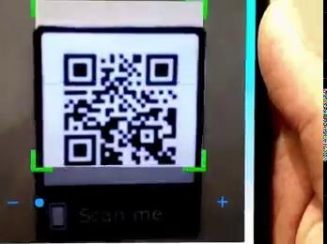
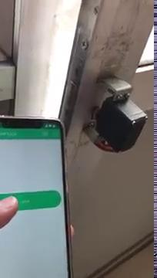
IoT - QR BASED DOOR SYSTEM
QR CODE BASED LOGIN
DOOR UNLOCKING

Slide 18
THANKS
A
TON

